Slide 1
Public Speaking, With a Twist
President Cooper Niemeier,
Reporter Shivali Singireddy
Please Enter with your camera ON and microphone off
Notes:
C: Hi and welcome to Public Speaking, but with an online twist. My name is Cooper and my fellow presentator is Shivali, and today we will be going over what is public speaking, how to improve your abilities at it, and how to use your public speaking skills online for TSA competitions. Before we jump in tho, it is probably important to define public speaking.

Slide 2
Public Speaking:
-The process of PERFORMING a speech to a live audience.
Notes:
S:

Slide 3
Focus on the 3 P’s
Posture
Projection
Presentation
Notes:
C: For TSA we like to think of the 3 P’s: Posture, Projection, and Presentation.
Posture is key, and the goal is to sit up straight… but not too straight. Having a relaxed, yet professional posture sets the tone for a positive presentation
Projection ensures your audience can hear everything you say. Don’t go too close to either pole. Mix it up to create emphasis in what you’re saying.
Presentation is the main bulk here. It involves everything from what you’re speaking about to the outfit you’re wearing to your visual aid.

Slide 4
Now, Lets Have You Try
Notes:
S: Lets go ahead and try some. I’ll give a key phrase and you give me a two to three sentence presentation on that subject. Remember to focus on the 3P’s

Slide 5
Name, School, and Grade
Notes:
S: *read title, have presenter turn on camera and mic

Slide 6
Favorite Part of TSA
Notes:
S: Same as last slide

Slide 7
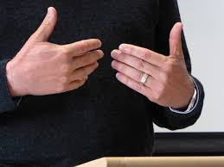
To Spice It Up, You Can Use Your Hands.
We can use four main type of gestures to boost a presentation
Descriptive Gestures
Emphatic (Emotional) Gestures
Suggestive Gestures
Prompting Gestures
Notes:
C

Slide 8
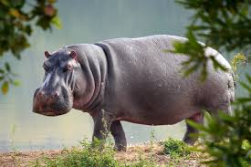
Notes:
C

Slide 9
Hook. Introduce. Points. Opinions.
Notes:
C: In TSA we like to follow a basis we call Hipo, not hypo.
Hook=a story, a quote, a question, something interesting to get the audience’s attention
Introduce=State your name ALWAYS and position or who invited you to speak
Points=Clearly state your points in order. Possibly give a brief intro to them but then go over each one in great detail.
Opinions=DO NOT GIVE AN OPINION UNTIL THE END!!!! You want to hit people with the facts first and then end with an ending opinionated statement.

Slide 10
HOOK
Notes:
S: This is the main attention grabber for your presentation. It is key to get the audience ‘hooked’ on early, or else the presentation could be doomed from the start.
Story
Question
interesting statistic
Anything that catches the attention of the audience

Slide 11
INTRODUCTION
Notes:
C: This is both an introduction for the speaker, and what they are covering. Include the purpose of the presentation, and go over common factors that the audience can expect later on in it.

Slide 12
POINTS
Notes:
S: These are the points of focus and the facts that come with them. They are what you are trying to present or argue in your presentation, but not the specific arguments itself. For instance, HIPO was one of the points in our presentation.
Facts
What you are presenting

Slide 13
OPINIONS
Notes:
S: Opinions are the arguments, or in literary terms, the commentary. This is where the speaker gives their opinions to comment on the facts and make commentary off of it.

Slide 14
Some Final Pointers
Positives:
Smile/ calming demeanor
Use correct volume
Make eye contact
Read your audience
Negatives:
Filler Language (Um, Uh)
Going off topic
Do not bore the audience
Reading off a full script
Notes:
Cooper Slide

Slide 15
Moving into the Online World
With Indiana TSA hosting their first virtual State Conference in April, it is more important now than ever to know how to apply what we went over to online presentations.
Notes:
S: Read something close to what's on the slide

Slide 16
Things To Watch For When Presenting
Be visible
Diversify your tone
Be interactive
Have an in depth visual aid
Simplify your slides
Avoid chaotic movements
Stay on time
Notes:
Cooper:

Slide 17
Sell Me This...
Notes:
S: Now we will do some more timed presentations. You’ll have a minute to think of what you’re going to say, then three minutes to present it. We will give feedback after.

Slide 20
Paint The Surrounding Story...
Notes:
Cooper: Same rules as before, but now you are painting the story of what happened before this picture. Its up to you to determine how far back you go, but still follow the guidelines on how to make a successful speech.

Slide 21
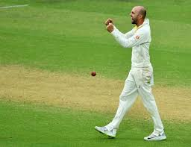

Slide 22
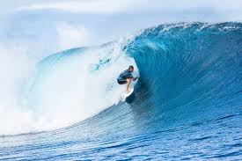

Slide 23
