Slide 1
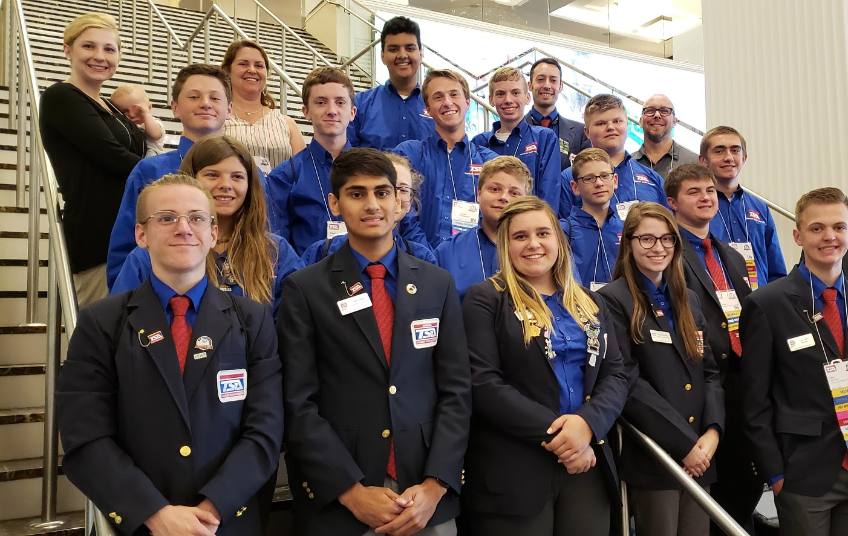
Indiana technology student association
WWW.INDIANATSA.ORG

Slide 3
Name that innovator

Slide 4
Innovator #1

Slide 5
Innovator #2

Slide 6
Innovator #3

Slide 7
Innovator #4

Slide 8
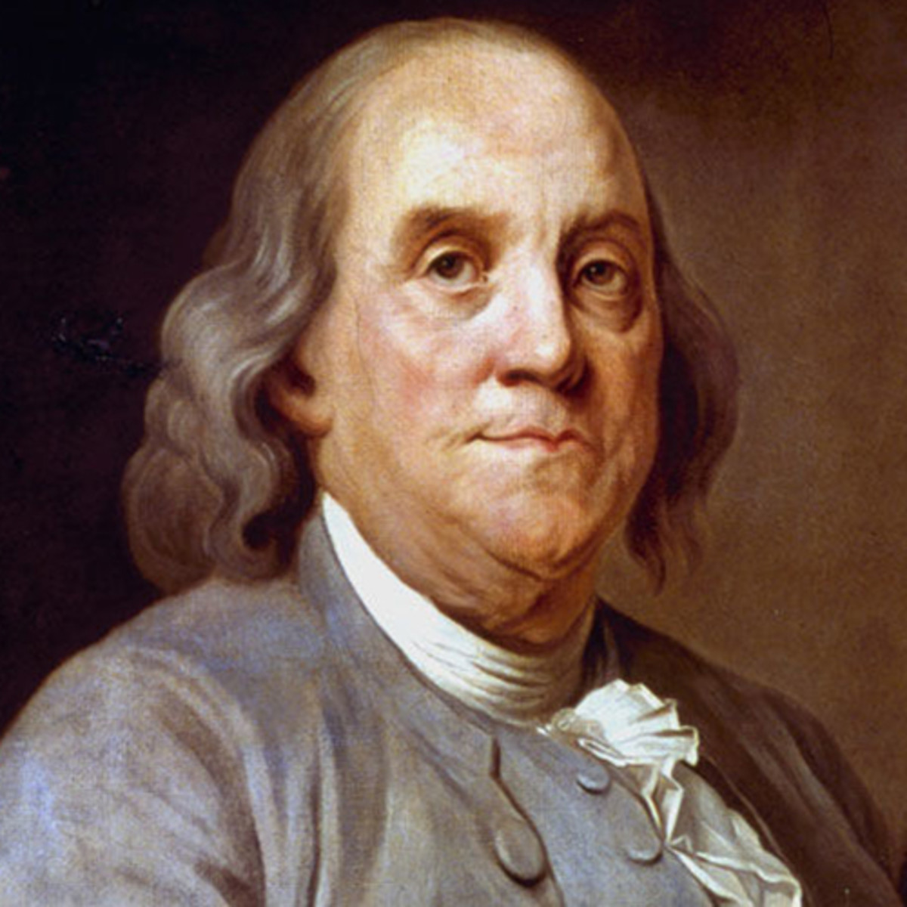
Innovator #5

Slide 9
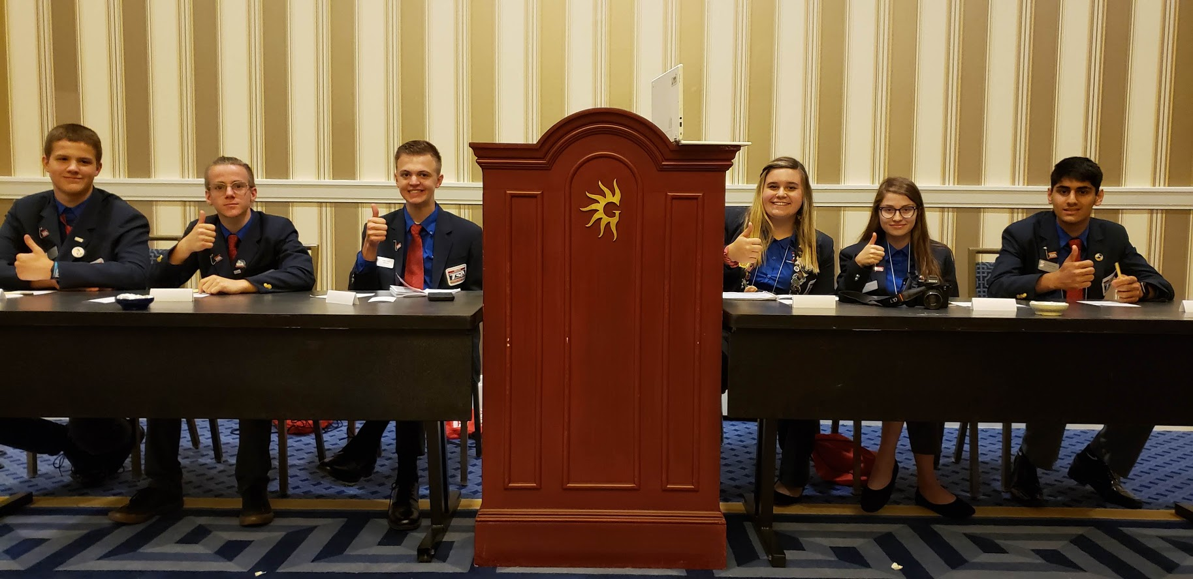
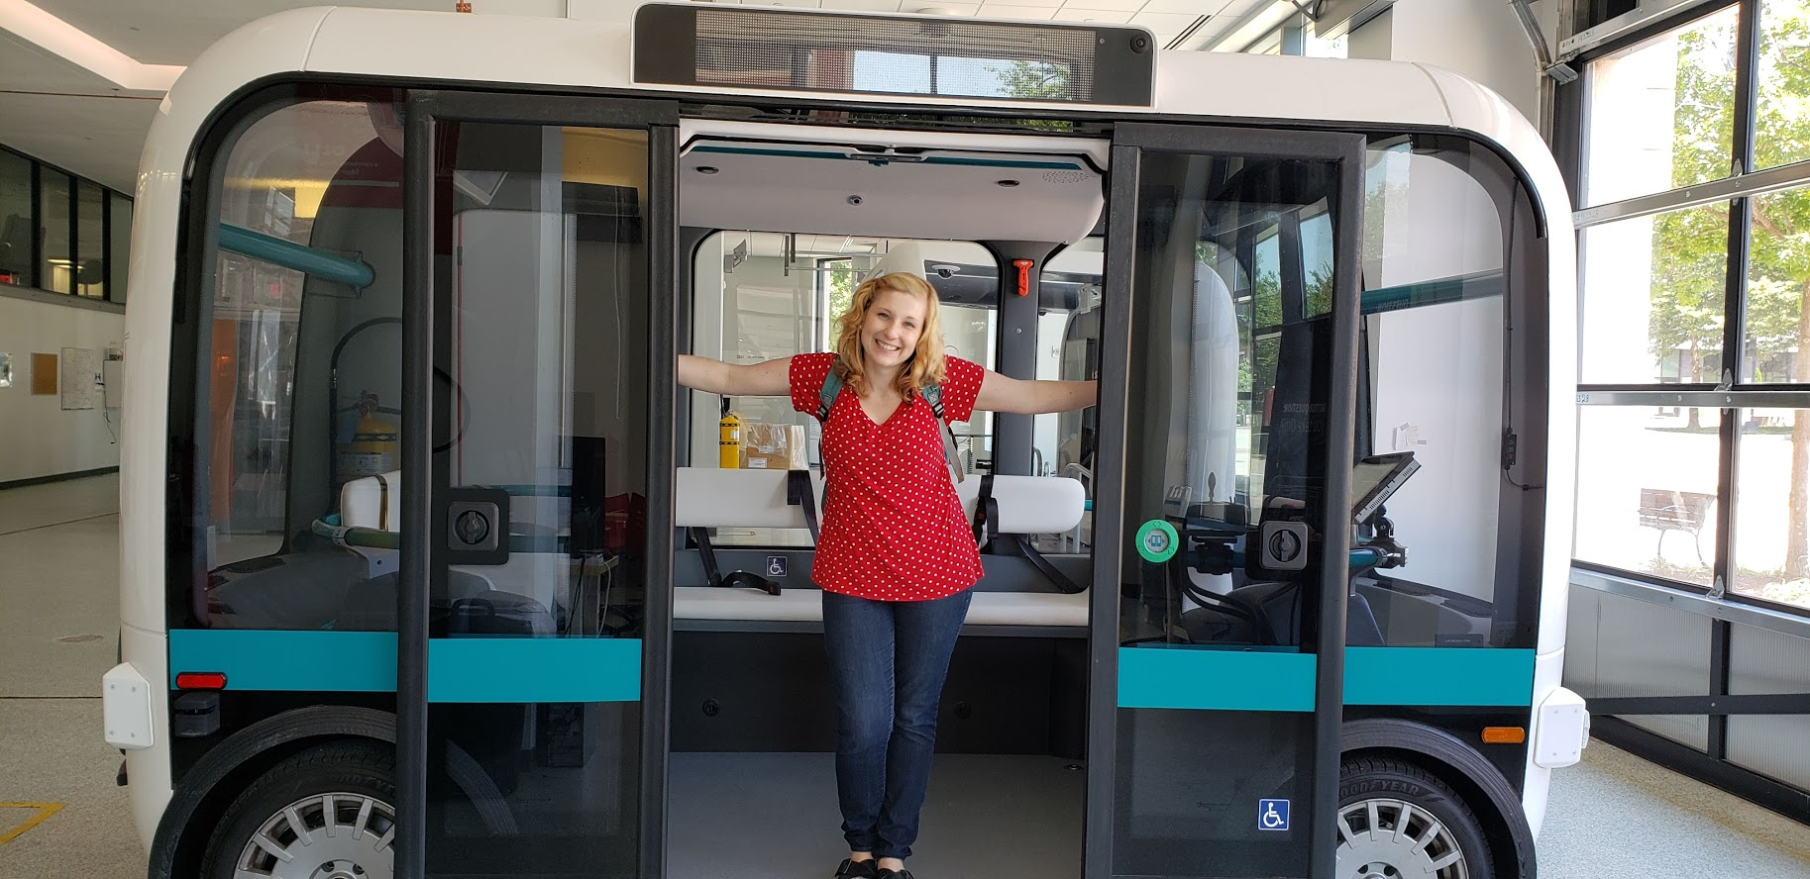
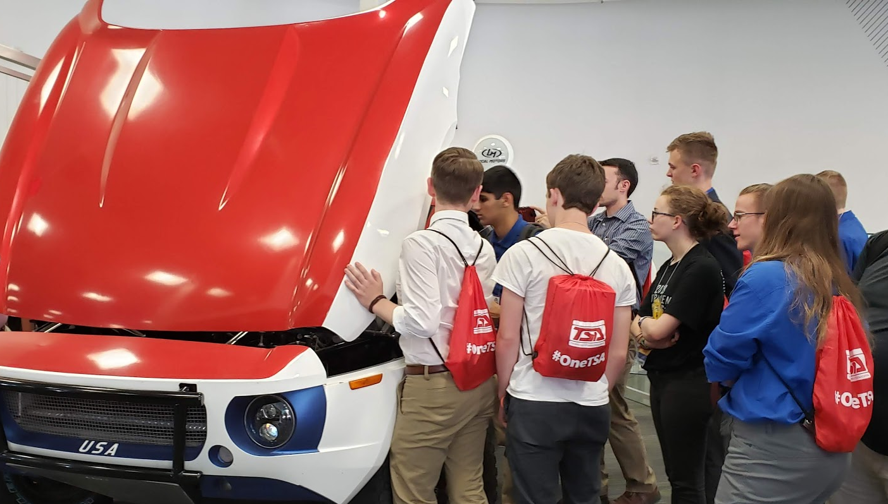
Why tsa?
Create the innovators of tomorrow
Less cooks and more chefs
Hands-on exploration
Use TSA competitions as classroom projects
Leadership opportunities

Slide 10
What is the Technology Student Association?
The Indiana Technology Student Association (TSA) is the Indiana delegation of National TSA, a national, non-profit organization of middle and high school students engaged in science, technology, engineering, and mathematics (STEM).
Indiana TSA has more than 200 members across the state.
We have 12 high school and 1 middle school chapter.
We have a Fall Leadership Conference and a Spring State Conference.
We offer leadership training, competitive events, professional development for advisors, networking, and more!

Slide 11
What does Indiana TSA Represent?
Mission Statement
The Technology Student Association fosters personal growth, leadership, and opportunities in science, technology, engineering, and mathematics (STEM); members apply and integrate these concepts through co-curricular activities, competitions, and related programs
Motto
Learning to Lead in a Technical World

Slide 12
Why Join TSA?
TSA provides student members the opportunity to explore a wide variety of career interest areas in a hands-on environment that takes them outside school walls
TSA offers over 60 middle and high school events combined − which are correlated with national STEM standards
TSA competitions can be integrated into and enhance STEM curriculums

Slide 13
TSA Programs
TSA offers multiple STEM programs to members in addition to TSA competitions. These programs include:
Tests of Engineering Aptitude, Mathematics, and Science (TEAMS): one-day engineering competition where students work together to apply their knowledge and STEM skills to issues facing our global society
Junior Solar Sprint: solar car competition for middle school students sponsored by the Army Educational Outreach Program (AEOP)
UNITE: summer program for high school students historically underrepresented in STEM sponsored by the AEOP
VEX Robotics: students learn about STEM through robotics in a hands-on competition

Slide 14
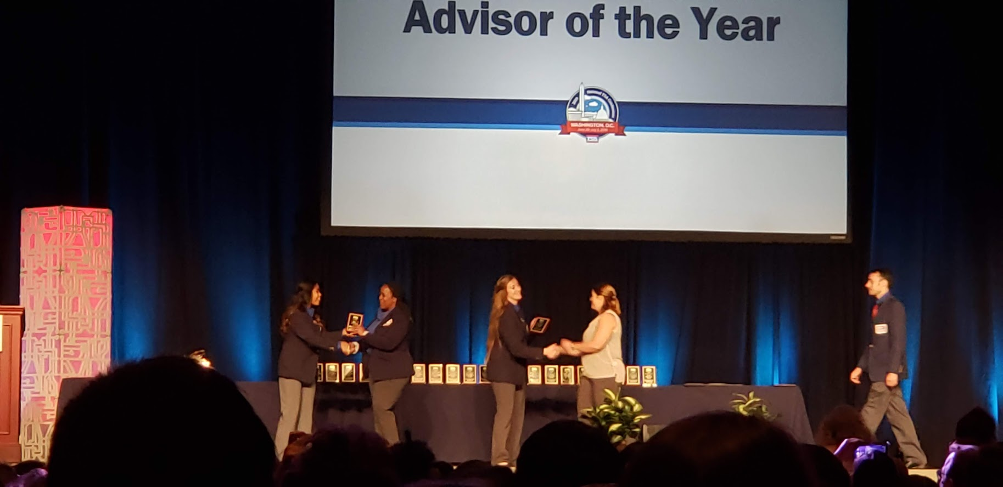
Why Join TSA?
Benefits for Students
Benefits for Teachers
Challenging and diverse STEM competitions
Furthering career and technical skills
Attending state and national conferences
Developing teamwork and presentation skills
Participating in service projects
Recognition for accomplishments
Networking opportunities with members
and industry professionals
Intracurricular Lessons
Organization
Plan of Work for the Year
Network with other E&T Teachers and members of Industry
See your students grow and excel!

Slide 15
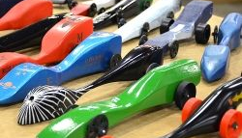
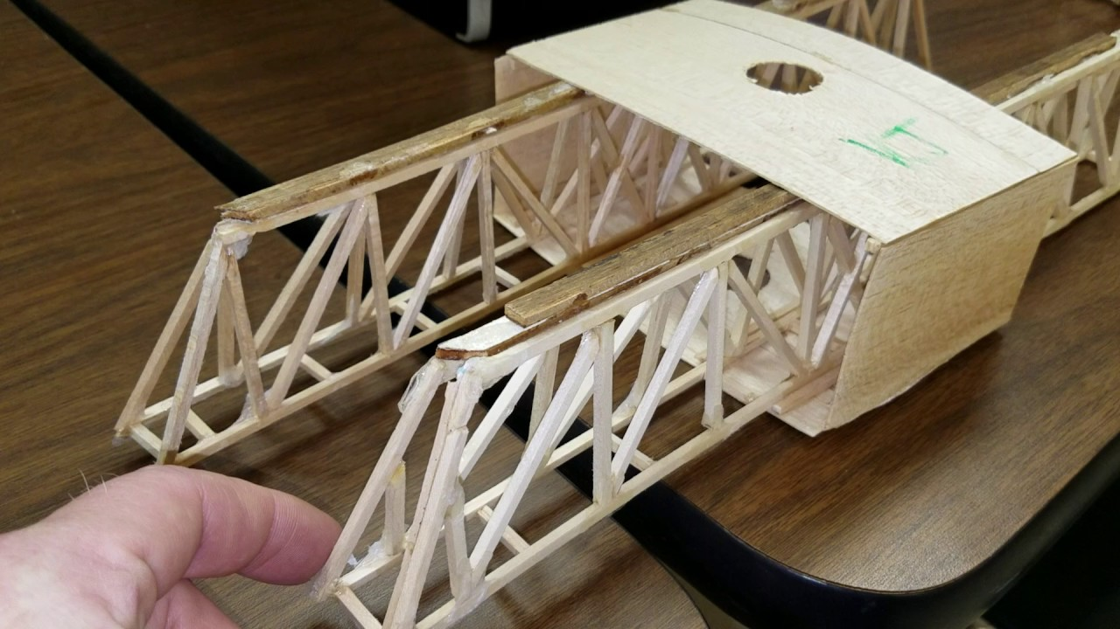
TSA Competitions
TSA’s 60 plus competitions provide an opportunity for students to take learning outside the classroom and explore topics of interest
Teachers can use TSA’s activities during the school day and extend learning during chapter meetings
Examples of high school competitions:
CAD 2D & CAD 3D
Debating Technological Issues
Engineering Design

Slide 17
TSA Chapters
TSA members within a school operate as part of a TSA chapter
In order to have a strong TSA chapter, the chapter must have:
A motivated membership
An engaged instructor/advisor
A cooperative team of chapter officers
Endorsement of the school administration

Slide 18
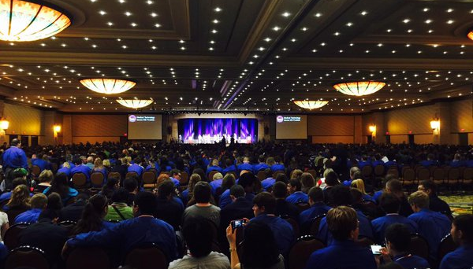
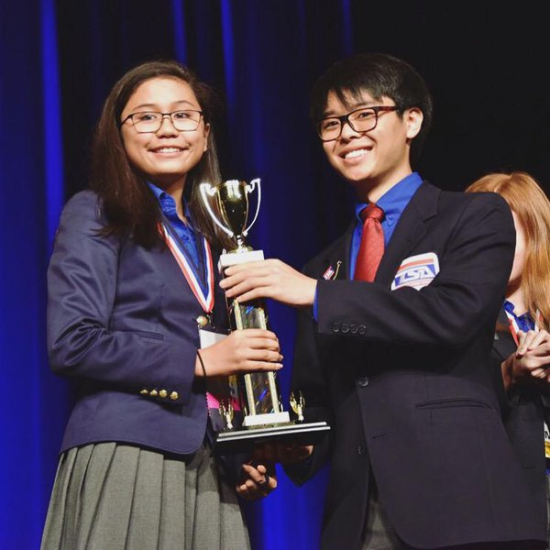
National TSA Conference
The national TSA conference is held annually at the end of the school year in June-July
Over 60 middle and high school competitions take place
Leadership training is offered
TSA Meet and Greet
Recognition awards
Social events

Slide 19
Learn More & Contact Indiana TSA
Mary Rinehart
Education Director
mary@1stmakerspace.com
Share your experience on Social Media!
@IndianaTSA
#theTSAway
WWW.INDIANATSA.ORG

